Slide 1
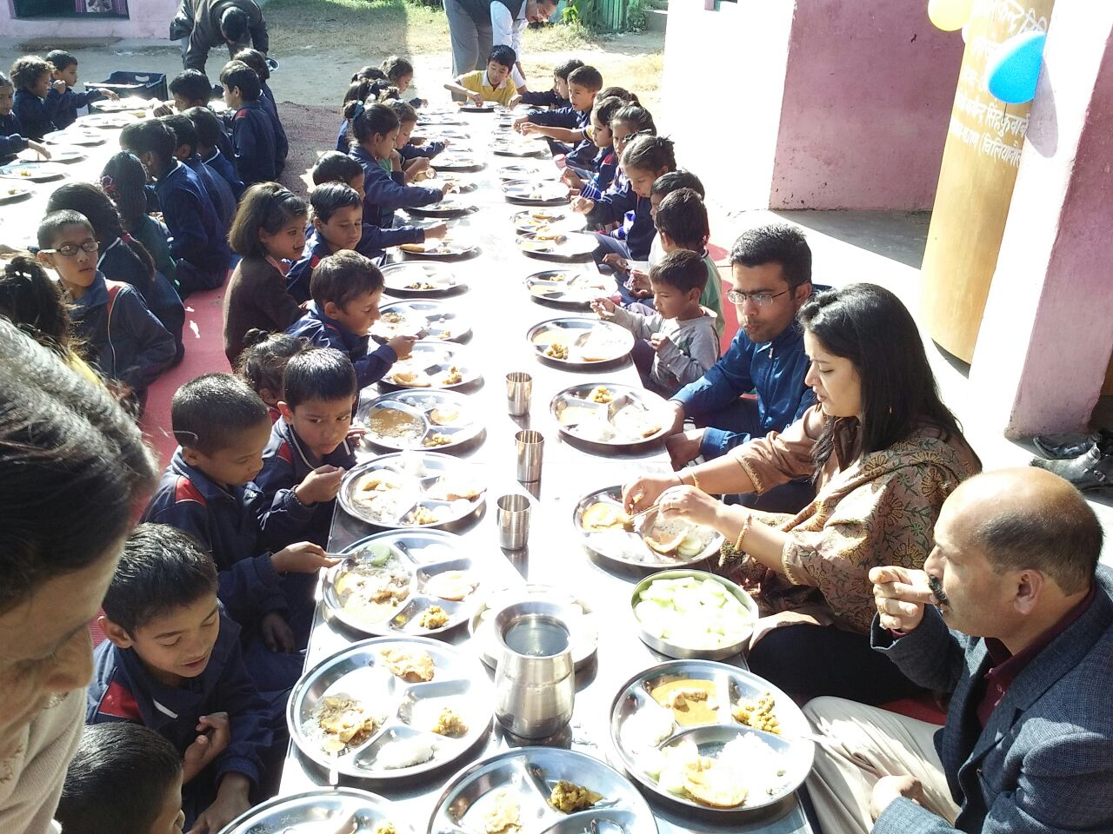
PAB MEETING
2018-19
UTTARAKHAND

Slide 2
Best Practices
“The Hans Foundation” an NGO is providing gas connections and Gas chulhas for 5519 schools in the state. At this time there are 4563 schools has been covered with gas connections and 3536 schools with gas chulhas. Click for chulha pictures
A new innovative concept of “Apna Kitchen Apna Bhojan ” ” has been introduced in the state to develop a work culture among children and to promote the will of working together and cooperation. The programme is being conducted once a week in schools.
click for pictures
”
State govt. has provided Rs 195.98 lac for 285 Primary & Upper Primary Schools to procure 3397 dinning tables & sitting mats for use of 20274 children.

Slide 3
Best Practices
The state has introduced the use of Iron Skillets to cook at least one meal under MDM programme. As on date, around 2613 primary and upper primary schools are using Iron Skillets. Click for pictures
The MDM scheme received a sum of Rs. 30.00 Lac by sale of empty gunny bags of food grains. The fund was utilized for purchasing Iron Skillets in 673 primary & Upper Primary schools of state.
Initiative was taken to establish “Kitchen Garden” in school premises where land is available. Now 1023 Kitchen Gardens have been established. Click for pictures
”
The concept of “Vishesh Bhoj has also been introduced in Mid Day Meal scheme, wherein anyone can organizes special lunch for the children on special occasions of birthday, marriage anniversary etc. A total of 863 schools organized Vishesh Bhoj in 2017-18. Click for pictures

Slide 4
Best Practices
The MDM cell undertook a “Food Quality Testing” exercise on 26th March 2018 With the help of “Punjab Biotechnology Incubator, Mohali (Punjab)”. The food samples were taken from 10 schools (30 Samples) in Dehradun, Tehri, Pauri & Haridwar districts.
For daily monitoring of Mid Day Meal, the SMS Based Automated Monitoring System is implemented in state in which all schools teachers provide per day information like enrolment and meals served for daily basis by simply doing SMS to toll free number 15544.
The USAATA (Uttarakhand Social Audit, Accountability and Transparency Agency) carried out “Social Audit” of MDM Scheme in 27 Schools of Khatima block, U.S.Nagar and 24 schools of Bhilangana block, Tehri in FY 2017-18.

Slide 5
Best Practices
In addition to daily menu of MDM, additional food Items “Atirikt Poshan ” for nutritional support is also provided in schools once a week (Rs 5 per child per week) that include Eggs, fruits & other nutritional items i.e.Gud Papdi, Ramdana laddu.
Incentive of Rs. 1000 per annum is given to all cook cum helpers. In addition to this Rs. 1000 will also be given to all cook cum helpers for Uniform.
State govt. increased Rs. 500 on monthly honorarium of cooks. Now total honorarium is Rs. 2000 monthly in which central share is Rs. 900 and State share is Rs. 1100.
State govt. also taken initiative to provide 11th month honorarium i.e. Rs 2000 to cooks as state share, previously it was only for10 months.
Daily Maintenance of Food Test Register & Tasting of food by SMC/Teachers before serving to children is made mandatory for all schools.

Slide 6
Institutions Covered Under MDM
Primary |  | Upper Primary |  | Total Schools (Primary & Upper Primary)
PAB Approval | MDM Served Institutions | PAB Approval | MDM Served Institutions | PAB Approval | MDM Served Institutions
In Mar 2018 (2017-18)
12438 | 12356 | 5292 | 5308 | 17730 | 17664
Enrollment & Beneficiaries under MDM
Primary |  |  | Upper Primary
PAB Approval | Enrollment | Beneficiaries | PAB Approval | Enrollment | Beneficiaries
In Mar 2018 (2017-18)
387654 | 441082 | 356138 | 269669 | 312801 | 248816
Notes:
Done

Slide 7
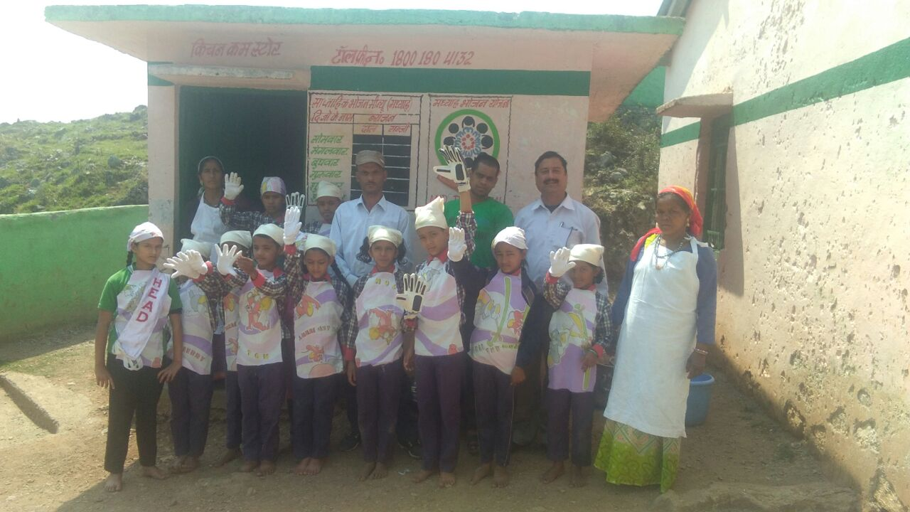
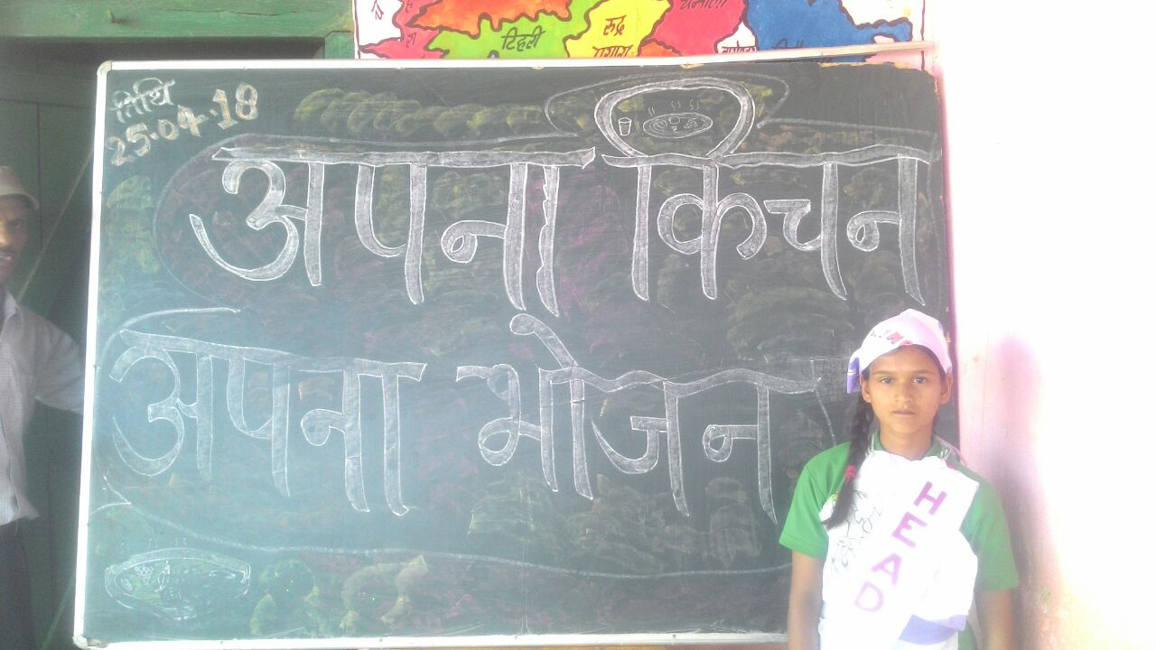
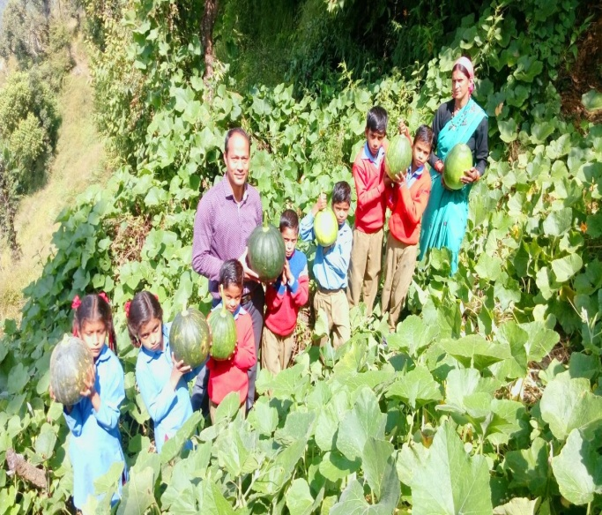
Food grains Utilizations (In MTs)
Level | Gross Allocation by GOI (Annually) | Lifting by DSOs from FCI | Released by DSOs to Schools
2017-18 (Apr 2017-Mar 2018)
PS | 8300.36 | 8299.04 | 8313.39
UPS | 8618.47 | 8614.20 | 8781.35
Total | 16918.83 | 16913.24 | 17094.74
Notes:
Done

Slide 8
FCI Payment
Level | Bills Submitted by FCI |  | Payment made to FCI
 | Quantity (In MTs) | Amount (in Lac) | Quantity (In MTs) | Amount (in Lac)
Apr 2017- Mar 2018 (2017-18)
PS | 8299.04 | 254.51 | 9003.46 | 277.01
UPS | 8614.20 | 264.14 | 9361.24 | 287.99
Total | 16913.24 | 518.65 | 18364.70 | 565.01*
* The cost of food grains bills of feb & march 2017(Rs. 46.30 Lakh), have also been paid during financial year 2017-18

Slide 9
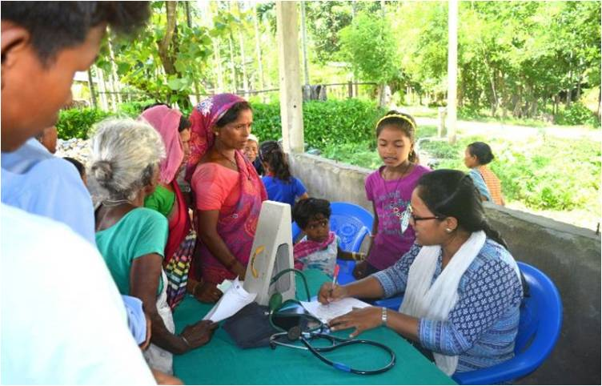
Health Check Up Status
Total Schools Covered | Total Children examined | Children identified with different Diseases | Children referred to nearest PHC/Hospital | No. of Spectacles distributed
Apr 2017-Mar 2018 (2017-18)
19016 | 896534 | 155216 | 21317 | 4662
Diseases Identified in total examined children
Diseases | Apr 2017 –Mar 2018
Refractive Errors | 1.25
Skin Infections | 1.94
Dental Diseases | 5.59
Ear Problems | 0.77
Physical & Mental illness | 0.22
Severe Anaemia | 0.24
Other Diseases | 7.29
Report 1 2 3 4 5
Notes:
Done

Slide 10
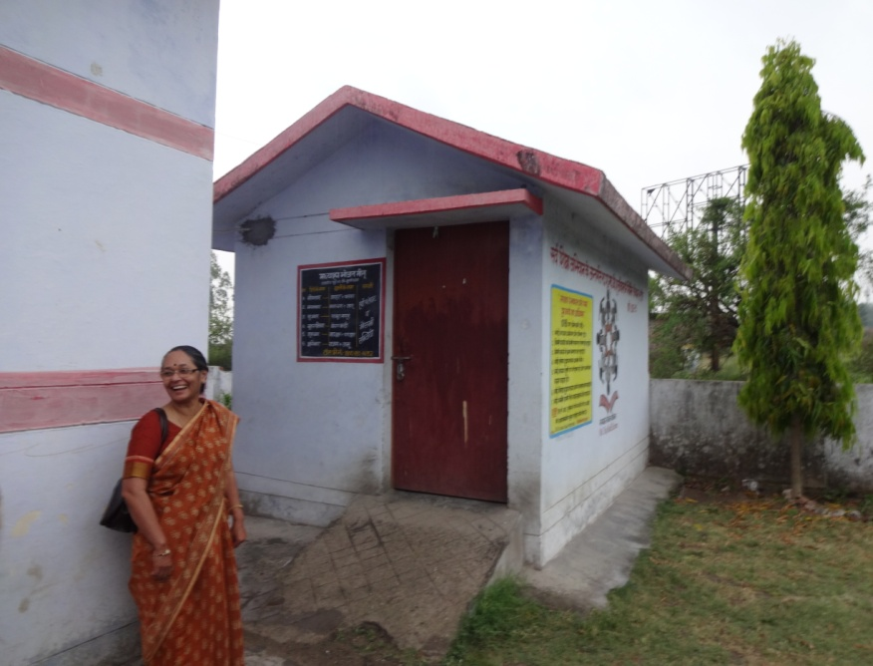
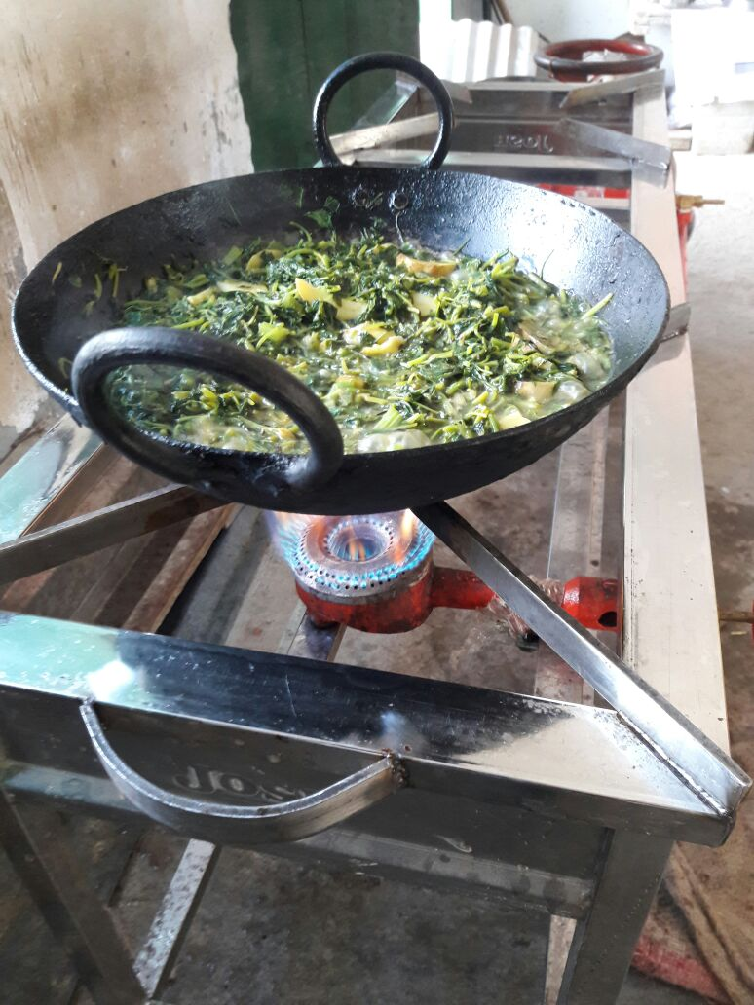
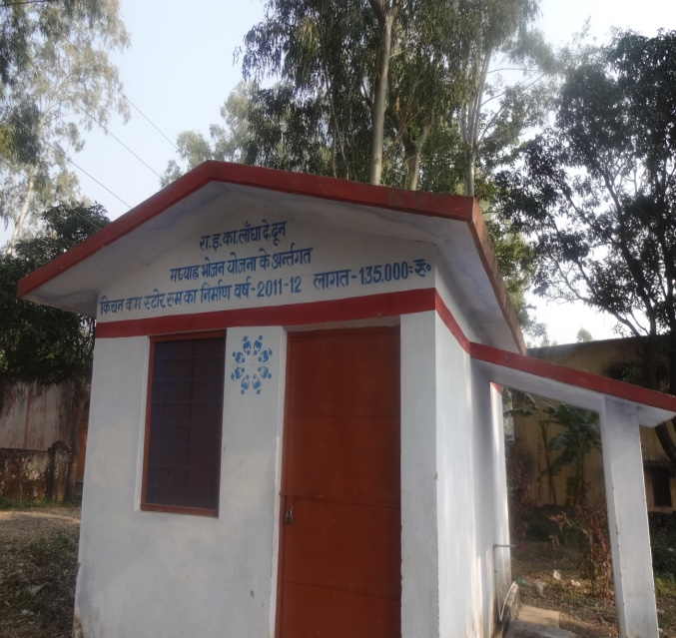
Kitchen Cum Store Progress
Total Kitchen Cum Stores sanctioned | Total Constructed | In Progress | Yet to Start | Remark
Up to Mar 2018 |  |  |  | SLSMC has decided not to construct KS where enrolment is less than 10. Due to change in plinth area, 27 kitchen extra constructed.
15933 | 15611 | 63 | 286

Slide 11
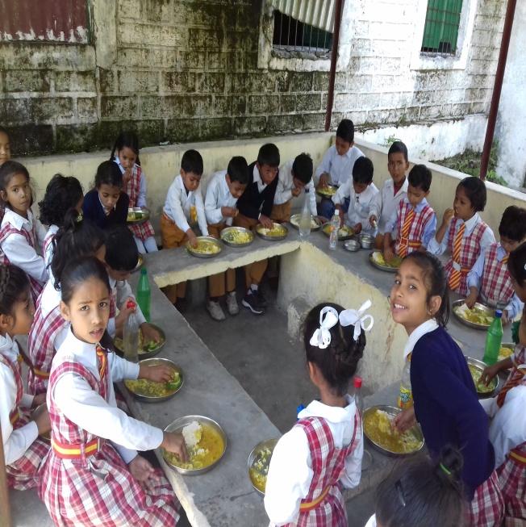
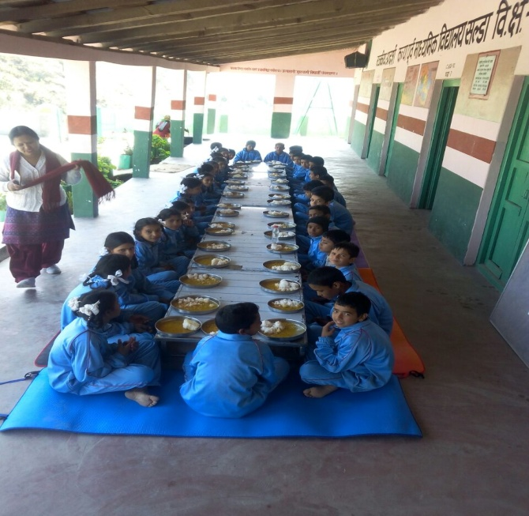
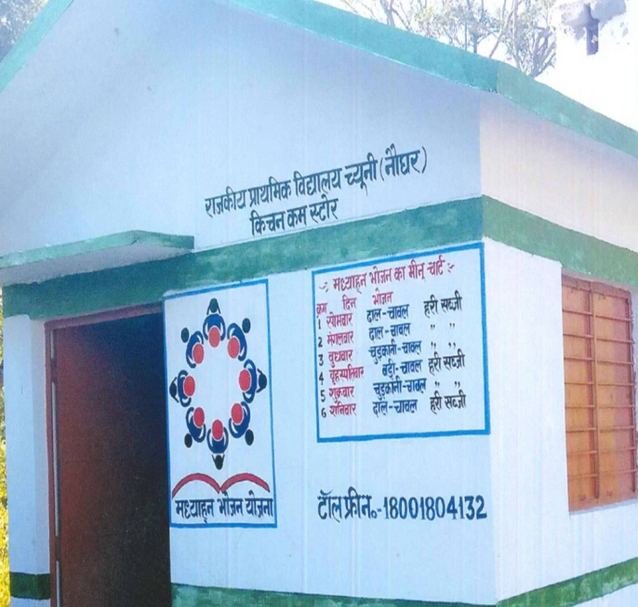
Budget Utilization (Rs. in Lac)
Total Approval | Opening Balance (Central+ State) | State Releases including Central Share | Expenditure | % Expenditure against Release+OB
Apr 2017- Mar 2018
18133.07 | 1711.71 | 15826.40 | 15220.15 | 87%

Slide 12
Category wise Cooks Engaged
Category | No. of Cooks
SC | 3397
ST | 1277
OBC | 5100
Minority | 658
General | 16943
Total | 27375
Cook Cum Helper Training At IHM Dehradun
Cook Cum Helper Training by SCERT
Meal Served By Cook Cum Helper at school
Notes:
Done

Slide 13
Issues
1- Cooking cost needs to be increased to deliver the prescribed nutritional value in MDM Scheme.
2- LPG subsidy should be reimbursed where LPG cylinders usage is more than 12 per annum.
3- Schools having more than 50 students, the cost of Kitchen Devices needs to be increased proportionately.
4- Transportation of LPG cylinders to rural and remote schools should be provided.
5- Cook cum helpers honorarium needs to be increased.

Slide 14
PHOTO GALLERY

Slide 15
Ro/Water purifier installed in schools

Slide 16
KiTCHEN GARDEN
GIC THOULDAR TEHRI
PS TILIYAPUR US NAGAR

Slide 17
KiTCHEN GARDEN

Slide 18
Vishesh bhoj
Vishesh Bhoj organised in
PS MATLI DUNDA UTTARKASHI
Vishesh Bhoj organised by Joint Magistrate Ranikhet, Almora in
PS MAYU MATILA TARIKHET

Slide 19
Vishesh bhoj

Slide 20
Iron kadhai in schools

Slide 21
YOGA in schools

Slide 22
Health check ups in schools

Slide 23
Thank You

